Slide 1
BEN’S DINOSAUR FACTS

Slide 2
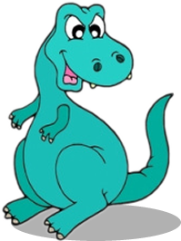
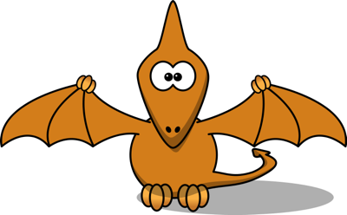
DINOSAURS
Click on a Dinosaur to find out its name

Slide 3
DINOSAUR JOKES
What do you call a Dinosaur with one eye?
Doyouthinkhesawus

Slide 4
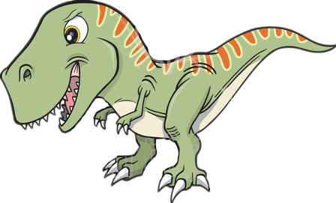
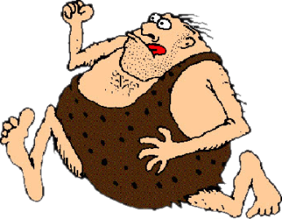
DINOSAUR MYTHS
Not all prehistoric animals were dinosaurs
Not all Dinosaurs were huge
People did not live at the same time as Dinosaurs

Slide 5
INSTRUCTIONS
Step-by-step instructions

Slide 6
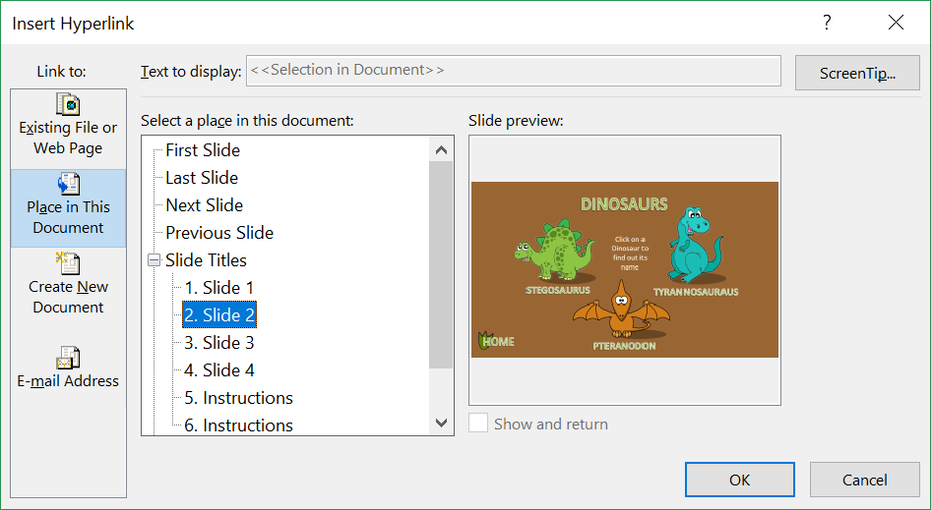
STEP 1
Click on the Dinosaur button on Slide 1
Click on “Insert” (from the toolbar) and click on “Hyperlink”
Click on “Place in This Document” and select “Slide 2”
Click OK
REPEAT this for the “Jokes” button and “Myths” buttons
REPEAT this for “Home” buttons on pages 2, 3 and 4

Slide 7
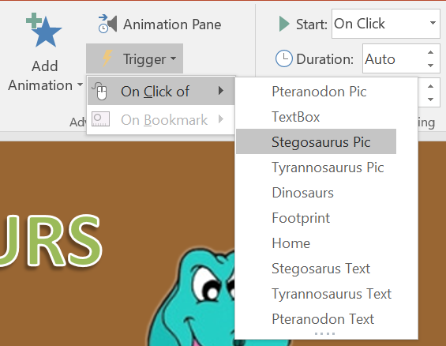
STEP 2
Click on Slide 2
Click on the “Stegosaurus” label
Click on “Animations” (from the toolbar) and click on “Appear”
Click on “Trigger”
Select “On Click of”
Select “Stegosaurus Pic”
Click “OK”
REPEAT for Tyrannosaurus and Pteranodon

Slide 8
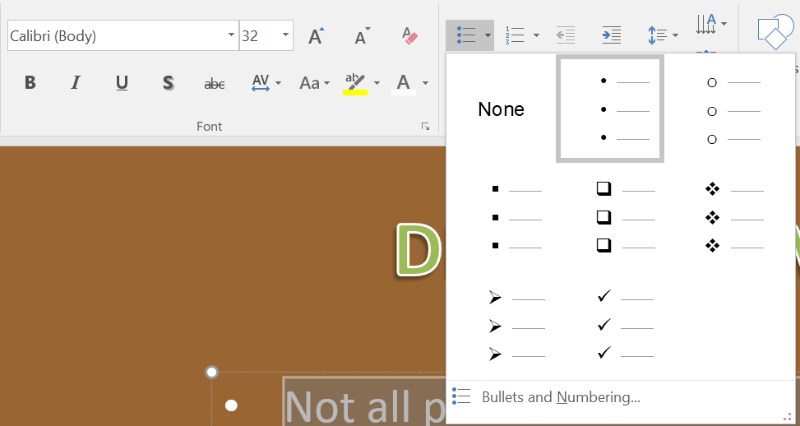
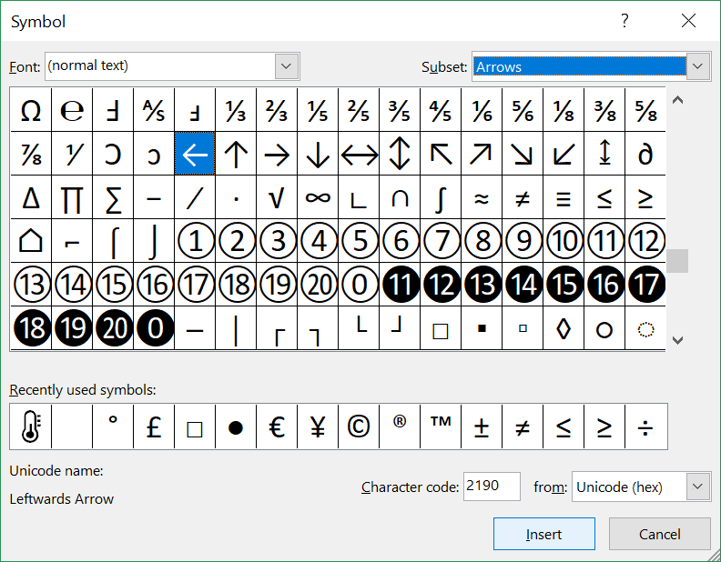
STEP 3
Click on Slide 4
Highlight ALL the bullet pointed text
Click on “Home” and click on the “Bullet Point drop-down button”
Click on “Bullets and Numbering”
Click on “Customize…”
Select “(normal text) and “Arrows”
Select the leftwards arrow key “←”
Click on “OK”
Click on the “Fill Colour Tool” and choose “Green”

Slide 9
STEP 4
Finally: Let’s stop PowerPoint from automatically advancing to the next slide every time you click the mouse button or press a key. To do this:
Click on Slide 1
Click on “Transitions” (from the toolbar)
Untick the “On Mouse Click” check box beneath the “Advance Slide” tab
REPEAT this for slides 2, 3 and 4
Click on “Slide Show” and “Set up Slide Show”
Tick “Browse at a Kiosk (Full screen)”

Slide 10
STEP 5
Delete all the instructions!
(Delete slides 5 to ?)
Test your presentation

