Slide 1
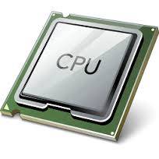
CPU Dingbats

Slide 2
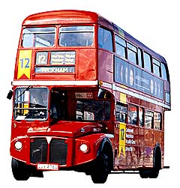
CPU Dingbats: Practice
See if you can guess the keywords from the pictures.
+A+

Slide 3
CPU Dingbats: Practice
See if you can guess the keywords from the pictures.
+A+
Answer: Data Bus.

Slide 4
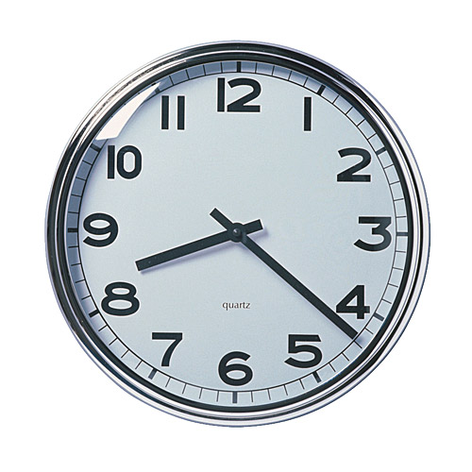
CPU Dingbats: Round 1
Notes:
Answer: Clock Speed

Slide 5
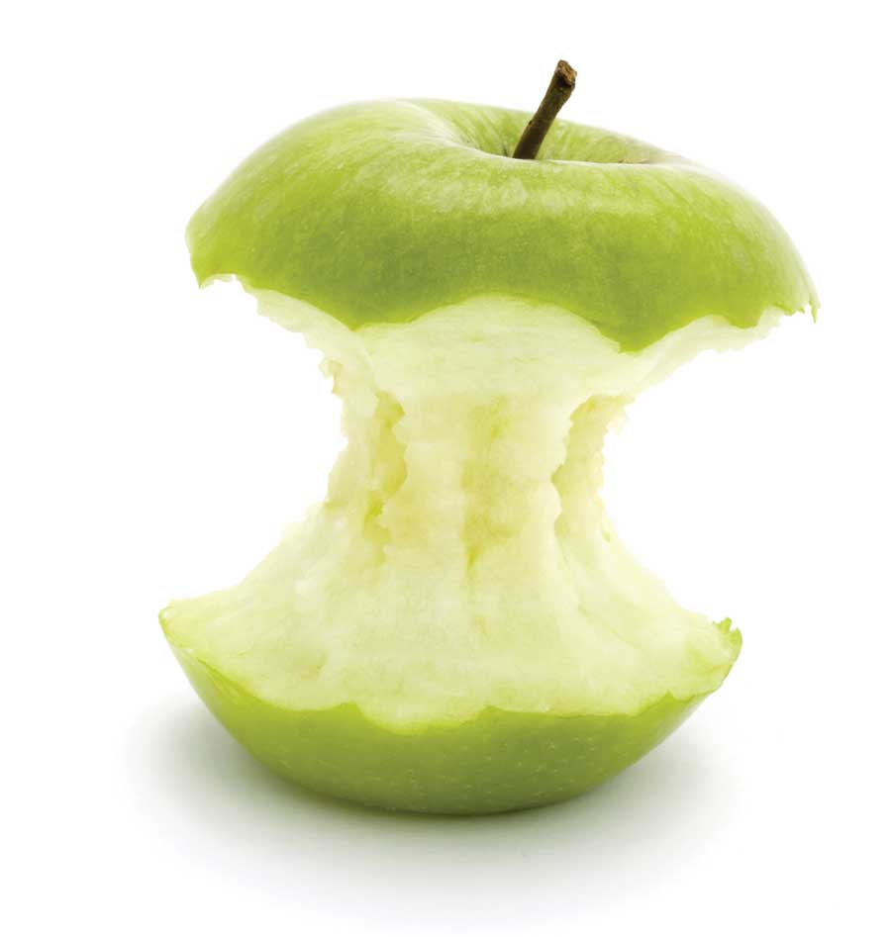
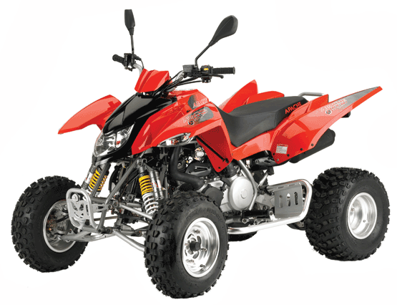
CPU Dingbats: Round 2
Notes:
Answer: Quad Core

Slide 6
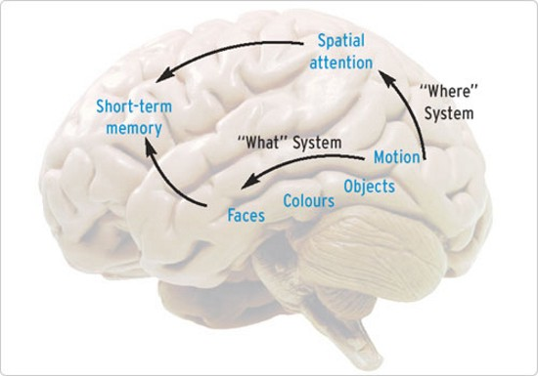
CPU Dingbats: Round 3
+
Notes:
Answer: Cache Memory

