Slide 1
Introduction to TouchDevelop
Lives:
Lesson 4 – My First Game: Part 2
High Score: 10000

Slide 2
TouchDevelop My First Game
Lives:
“Tin Can Game – Part 2”
High Score: 10000

Slide 3
Learning objectives
To know how to keep score in TouchDevelop
To know how to create a leaderboard.

Slide 4
My first game – Part 2
In this tutorial, we are going to add two new elements to our Tin Can game to make it more challenging.
First we will add a score board and link it to an online leaderboard so you can challenge your friends. Finally we will add some lives to make the game more challenging.

Slide 5
Getting started
Open the TouchDevelop app by visiting http://touchdevelop.com/
Login to your account.
Tap on your Tin Can Game script.
Tap on edit.

Slide 6
TouchDevelop My First Game – Part 2
NEW
HIGH
SCORE!
“Adding a score board”

Slide 7
Adding a score board
Let’s add a score board to make the game more challenging.
First we need to create a new variable to store the score.
Go to ▷ main()
Add a new line.
Tap var on the lower right keyboard.
Rename the variable score.
Set the score to 0.

Slide 8
Adding a score board continued 2...
Score
As we will need to regularly update the score, we need to store it in a global variable.
Move the cursor to the new variable.
Tap on promote to data.
Your code should look like this:
Next we need to create a text box to display the score on the screen.
Add a new line.
Tap var.
Rename the variable score sprite.
Global Variable

Slide 9
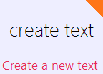
Adding a score board continued 3...
Tap on data from the lower right keyboard.
Tap on board.
Now let’s create the text box to display the number of lives on the screen.
Tap on create text.
By default, TouchDevelop will create a text with 100 pixels width, 20 pixels height and font size of 40.
width
height
font

Slide 10
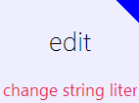
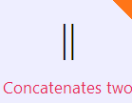
Adding a score board continued 4...
Tap on the double quotes.
Tap on edit.
Tap on the “abc” button in the lower left keyboard.
Type in Score: Hint: Make sure you leave a space at the end of the word “Score: “
Next we need to add the score on the end of the text. For this we will use the concatenation command. (Remember “Hello World” in lesson 1.)
Tap on II.

Slide 11
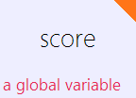
Adding a score board continued 5...
Tap on data.
Tap on score.
Finally, as we will be regularly updating the score, we need to store the score sprite in a global variable.
Move the cursor to the new variable.
Tap on promote to data.
Your code should look like this:

Slide 12
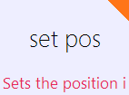
Adding a score board continued 6...
Sprites by default are placed in the centre of the game board. The sprite position can be changed using the set pos command.
Add a new line.
Tap on data.
Tap on score sprite.
Tap on set pos.
Now let’s enter the x and y coordinates for the life sprite.
Enter the following values: 100, 400.

Slide 13
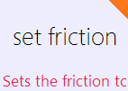
Adding a score board continued 7...
Run the game to see what happens.
Notice that the score sprite falls off the screen with the tin can. In order to stop the score sprite from falling, we need to apply friction to it.
Add a new line.
Tap data.
Tap score sprite.
Tap set friction.
Set friction to 1.

Slide 14
TouchDevelop My First Game – Part 2
NEW
HIGH
SCORE!
“Updating the score board”

Slide 15
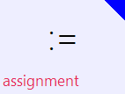
Updating the score board
Finally, we need to update the score every time the player taps on the tin can. We need to put this new code in the tap sprite: can sprite event.
Go to tap sprite: can sprite.
Add a new line.
Tap on data.
Tap score.
Tap on :=
Tap on data and score again.

Slide 16
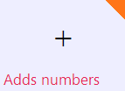
Updating the score board continued 1...
We are going to give the player 10 points for every time they tap on the tin can.
Tap + on the lower left keyboard.
Type in 10. Your code should look like this:
Run the code to see what happens.
Notice that the score does not change when we tap on the tin can. We need to display the updated score on the screen.

Slide 17
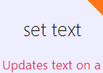
Updating the scoreboard continued 2...
Add a new line after the previous line of code.
Tap on data.
Tap score sprite.
To update the score we will use the set text command.
Tap set text.
Tap on the double quotes “”.

Slide 18
Updating the score board continued 3...
Tap on edit.
Tap on the “abc” button in the lower left keyboard.
Type in Score: Remember: Make sure you leave a space at the end of the word “Score: “
Next we need to update the score on the end of the text.
Tap on II.
Tap on data.
Tap on score.

Slide 19
TouchDevelop My First Game – Part 2
Lives:
“Adding lives”

Slide 20
Adding lives
Let’s add some lives to make the game a little more challenging.
Just like the score, first we need to create a new variable to store our lives.
Go to ▷ main()
Add a new line.
Tap var on the lower right keyboard.
Rename the variable life.
Set the number of lives to 3.

Slide 21
Adding lives continued 2...
Life
As we will need to regularly update the number of lives, we need to store it in a global variable.
Move the cursor to the new variable and tap on promote to data.
Your code should look like this:
Next we need to create a text box to display the number of lives on the screen.
Add a new line.
Tap var.
Rename the variable life sprite.
Global Variable

Slide 22
Adding lives continued 3...
Tap on data from the lower right keyboard.
Tap on board.
Now let’s create the text box to display the number of lives on the screen.
Tap on create text.
Your code should look like this:

Slide 23
Adding lives continued 4...
Tap on the double quotes.
Tap on edit.
Tap on the “abc” button in the lower left keyboard.
Type in Lives: Hint: Make sure you leave a space at the end of the word “Lives: “
Next we need to add the number of lives on the end of the text. For this we will use the concatenation command again.
Tap on II.

Slide 24
Adding lives continued 5...
Tap on data.
Tap on life.
Finally, we need to store the life sprite in a global variable.
Move the cursor to the new variable.
Tap on promote to data.
Your code should look like this:

Slide 25
Adding lives continued 6...
Next let’s re-position where the number of lives will be displayed on the screen.
Add a new line.
Tap on data.
Tap on life sprite.
Tap on set pos.
Now let’s enter the x and y coordinates for the life sprite.
Enter the following values: 650, 400.

Slide 26
Adding lives continued 7...
Run the game to see what happens.
Notice that the life sprite falls off the screen with the tin can. In order to stop the life sprite from falling, we need to apply friction to it.
Add a new line.
Tap data.
Tap life sprite.
Tap set friction.
Set friction to 1.

Slide 27
TouchDevelop My First Game – Part 2
“Updating lives”

Slide 28
Updating lives
Finally, we need to update the number of lives left on the screen every time the player loses a life. We need to put this new code in the gameloop.
Go to gameloop.
We need to add our new line at the end of our if statement which detects if the tin can has fallen off the board.
Find the if statement starting with the line:
Tap on the last line inside the if statement (above do nothing) and add a new line.

Slide 29
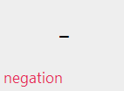
Updating lives continued 1...
First we need update the number of lives left.
Tap on data.
Tap life.
Tap on :=
Tap on data and life again.
No we are going to deduct 1 from life.
Tap – on the lower left keyboard.
Type in 1. Your code should look like this:

Slide 30
Updating lives continued 2...
Finally we need to display the updated number of lives on the screen.
Add a new line after the previous line of code.
Tap on data.
Tap life sprite.
To update the number of lives displayed we will use the set text command.
Tap set text.
Tap on the double quotes “”.

Slide 31
Updating lives continued 3...
Tap on edit.
Tap on the “abc” button in the lower left keyboard.
Type in Lives: Remember: Make sure you leave a space at the end of the word “Lives: “
Next we need to update the number of lives on the end of the text.
Tap on II.
Tap on data.
Tap on life.

Slide 32
TouchDevelop My First Game – Part 2
GAME
OVER
“Ending the game”

Slide 33
Ending the game
Run the game to see what happens.
Notice that the game never ends and that the number of lives will eventually go into negative numbers. Not much of a challenge if the game never ends! We need to end the game when the number of lives reaches 0. To do this, we use the time → stop command.

Slide 34
Ending the game continued 1...
Before we can stop the game, we need to create a new if statement to detect when the number of lives reaches 0. We will place this new if statement in the gameloop event.
Go to gameloop.
Go to the last line of code and add a new line.
Notice this time there is no + symbol. In its place is this symbol.
Tap
Tap if on the lower right keyboard.
Tap on condition.

Slide 35
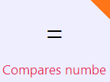
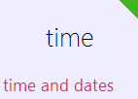
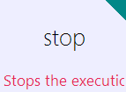
Ending the game continued 2...
Tap on data and tap life.
Now let’s check to see if the number of lives is 0.
Tap on =
Type in 0.
Tap on do nothing.
Tap time.
Tap on stop.
Run your game to see what happens.

Slide 36
TouchDevelop My First Game – Part 2
High Scores
Player 1: 1560
Player 2: 950
Player 3: 150
Player 4: 5
“Creating a leaderboard”

Slide 37
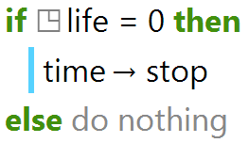
Creating a leaderboard
Wouldn’t it be fun to challenge your friends and post their scores online. Well, with TouchDevelop, you can do just that using the bazaar command!
First we must upload the players score to the leaderboard using the post leaderboard score command.
Go to the gameloop event.
We need to add the new code inside the if statement which detects if the number of lives reaches 0.

Slide 38
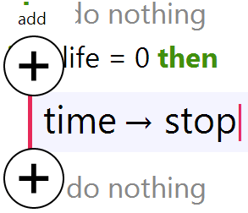
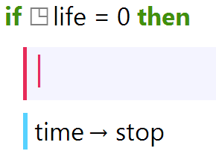
Creating a leaderboard continued 1...
Tap on the line containing: time → stop.
We need to add the new code above the time → stop command. If we add the new code after the time → stop command, the code will never run and the player’s score will not be posted to the leaderboard.
Tap on the + symbol above the time → stop command. The will add a new line above the time → stop command.

Slide 39
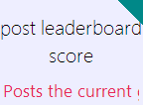
Creating a leaderboard continued 1...
Tap on bazaar.
Remember: If you can’t see the bazaar button, click on the blue arrow button to cycle through all the available options.
Tap on post leaderboard score.
Next we need to upload the player’s score.
Tap on 0 and delete.
Tap on data and score.
Your code should look like this:

Slide 40
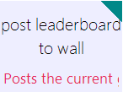
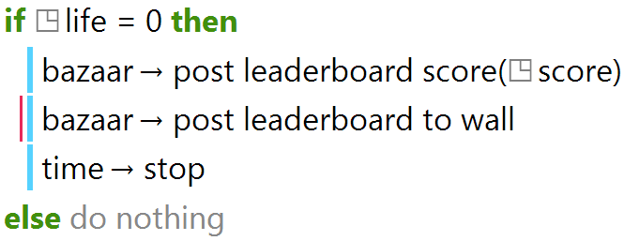
Creating a leaderboard continued 1...
Finally, we need to display the leaderboard on the wall. To do this, we use the post leaderboard to wall command.
Add a new line of code.
Tap on bazaar.
Tap on post leaderboard to wall.
Run the code to see what happens.

Slide 41
TouchDevelop My First Game – Part 2
“Publishing your script”

Slide 42
Publishing your script
Before you can challenge your friends and upload each others high scores to the online leaderboard, you must first publish your script.
Tap on publish.

Slide 43
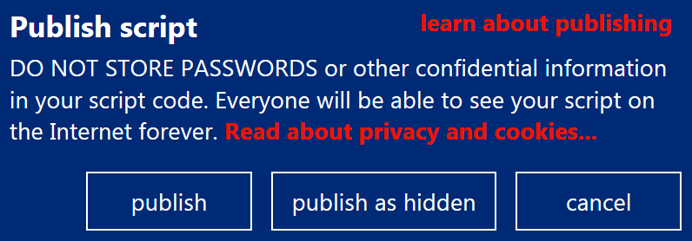
Publishing your script continued...
Note: As the warning suggests, once you tap on publish, everyone will be able to see your script.
If you are happy to publish your script for everyone to see.
Tap on publish.
Congratulations! You have created your first game.

Slide 44
TouchDevelop My First Game – Part 2
Challenge

Slide 45
Challenge
Challenge 1: Add code to re-spawn the tin can when it falls off the sides of the screen. Hint: You will need to use an if statement.
Challenge 2: Increase the speed of the tin can every time a player reaches 100 points. Or Add a second tin can when a player reaches 200 points.
Collaborate: Share your game with your classmates and see if they can improve your code.

